Slide 1
Cloud Pak for Data Governed Data Ops Deep dive

Slide 2

Governed Data Ops Modernize your Data Estate - Less Data Movement - Safe & Trusted - Reduce Dark Data
Accurate data driven decisions “With businesses that use data effectively poised to take $1.2 trillion away from their peers by 2020, it’s likely that we’ll see more of them making large-scale, cost-effective decisions.”
-Forbes
“A very exciting product ... molded in one technology suite.”
– James Wade, Director

Slide 3




Simplify patient data migration
GuideWell
It's a very exciting product. You have a lot of things that a lot of different companies are doing, molded into one technology suite.
Watch the video
Modernize
James Wade
Director of Application Hosting, GuideWell
Industry: Healthcare
Geography: North America
Unlock the value of your data for an AI and multicloud world
Hear why GuideWell, a rapidly growing healthcare company is excited about Cloud Pak for Data and its potential to use data securely to improve health outcomes for 15 million U.S consumers.
Solution
Cloud Pak for Data
“ Include a quote if one is available, we can always add this at closeout. ”
-- Include quote author’s name and title
“ Include a quote if one is available, we can always add this at closeout. ”
-- Include quote author’s name and title
Data and AI / © 2019 IBM Corporation

Slide 4
Overview
– Bring insights from “dark” data to business processes and decision making
–
Efficiency in data provisioning and access for citizen data users
–
Build trust and quality in data assets while infusing governance hygiene without red-tape
–
Reduce friction with self-service data management and governance
–
No more making copies of data that creates silos and version issues
–
ONE place to catalog all metadata with automatic data classification and business glossary
–
ONE place to provide secured auditable access to data assets
Business Challenges

Slide 5
Who to talk to
Questions to ask?
Chief Data Officer “Do you know all the data that you have and who is accessing it?
Office of the CTO
” How do you track data changes by the business owners?”
Compliance Officer “ Do you have an immediate answer to compliance needs of your industry?”
Chief Architect /CIO
“ What is your cloud strategy?”
Benefits of this pattern
Bring insights from “dark” data to business processes and decision making
Empower citizen data user with frictionless self- service workflows
Build data hygiene across enterprise through well defined org structure and ownership of data and processes
Create a next generation Data and AI driven Organization
Chief Data Officer
Office of the CTO
Chief Architect (includes Enterprise Data Architecture Standards Committee)
Compliance Officer (Compliance, Risk, and Enterprise Strategy)
Potential influencing personas
Line of business decision makers
Business SMEs and partners
Data Stewards, Data Engineers, Business Analysts, Data Scientists
Data – Ops teams

Slide 6

Identify/plan Governed Data Ops approach
Build Data Organizational Structure - Identify Teams/Roles
Define business data governance workflow
Build business context for data assets
Define data access processes without making copies of data
Build data security framework for trusted and safe access
Proactively monitor usage and refine data hygiene practices
Start with a set of pre-defined organization structure and identify initial data domains to onboard
Refine data governance policies and processes.
Understand tools and options available for building business metadata/glossary, categories, polices and rules. Setup auto-discovery and data quality matrix.
Define roles and responsibilities for data virtualization and data asset management. Create workflow required to meet enterprise standards.
Create security framework for data assets managed within data virtualization.
Monitor usage and consumption of data assets across analytics projects and build a sustainable data hygiene

Slide 7
Build Data Organizational Structure
Modern data fabric in any enterprise is a team sport or rather a sports league. Every line of business including corporate groups should own and participate
Create data governance council who will represent key line of businesses
Identify roles and responsibilities based on each data domain. Start small with 1-2 domains and expand
Setup roles and responsibilities for governance activities
Create workflow and procedures for teaming
Identify data domain scope
Monitor and measure effectiveness and revise
Document consistent understanding of owners and responsibility across enterprise

Slide 8
Define business data governance workflow
The teams and roles need to share responsibility to make sure the data assets are curated with oversight from stakeholders
Governance workflow with define Data Stewards and Data Engineers roles and their interaction
Identify domain scope and owner for subject area
Identify workflow pattern for business glossary and cataloging functions
Setup process for initiation and approval process for publishing assets in catalog
Monitoring and measuring data governance activities
Periodic catalog quality and validation
End user activity and usage monitoring
Customize governance workflow template for enterprise adoption

Slide 9
Build business context for data assets
Business context to data assets make data meaningful and usable in consistent way across processes and applications
Build business metadata and can be used by automated classification processes
Identify data domain scope
Create high level categories and Terms hierarchy
Auto Discover and auto classify data objects
Validate and approve classification and revise
Industry Accelerator to import pre-defined metadata
Consolidated business glossary and catalog management workflow

Slide 10
Define data access processes without making copies of data
Data latency prevents many analytics projects from starting. Give a head-start to your analytics initiative by using data virtualization features
Create key entities and potential features as virtualized data assets
Create roles such as data engineer, user, admin with data virtualization
Consolidate schema with “schema folding” feature to group like subject areas
Setup roles and responsibilities for data virtualization activities
Create workflow and procedures for data provisioning through DV pre-joined assets
Identify data domain scope
Create access control for audit and compliance
Data Virtualization best practice across enterprise domains

Slide 11
Build data security framework for trusted and safe access
Define data security at data virtualization layer, project and catalog
Assign roles and responsibility for security activities
Identify audit and logging capabilities for compliance
Setup roles and responsibilities for data security activities
Create workflow and procedures for access and audit
Identify data security scope
Monitor and setiup alerts
Data security workflow and best practices for monitoring ongoing activities

Slide 12
Proactively monitor usage and refine data hygiene practices
Define matrix for data usage and monitoring
Create consolidate reports for access patterns and data asset inventory
Setup roles and responsibilities for platform governance as whole
Create workflow and procedures for measurement matrix
Identify platform usage scope
Monitor and setiup alerts
Create measurable KPIs for ongoing success of data initiative in the enterprise

Slide 13
Governed Data Ops Pattern
Cloud Pak for Data Base Entitlement
High-level Architecture
App
App
App
Secured access
Data Virtualization
Data Scientists
Data Sources
Catalog and workflows
Data scientist’s sandbox
Business Terms
Secured access
Knowledge worker
Data Sources
Central Access
Data Virtualization
Business Policies
AI/ML Tools
Deployment Tools
Data Sources
Data Engineer
Data Security and Audit
Governed Data Plane
Data Steward
Secured access
Data Security and Audit

Slide 14
Governed Data Ops Pattern
High-level Architecture
App
App
App
Secured access
Data Virtualization
Data Scientists
Data Sources
Data scientist’s sandbox
Business Glossary
Enterprise Catalog
Secured access
Knowledge worker
Data Sources
Central Access
Data Virtualization
Business Policies
AI/ML Tools
Deployment Tools
Data Sources
Data Engineer
Data Security and Audit
Governed Data Fabric Layer
Data Steward
Secured access
Data Security and Audit

Slide 15
Scope of Initiate phase – Governed DataOps
Services Package Overview
Work with customer to identify data fabric pattern, topology and provision an environment using customer provided infrastructure and help onboard initial users, data sources and establish initial data governance hygiene. You will also get proactive support to operationalize your solution for one year.
Business Value
Start on the right foot with a discovery workshop to outline deployment approach and topology
Get a head-start with expert working side-side to build core platform and governance skills
Setup data fabric as central data hub for all metadata across data assets for self-service frictionless access
Deliverables
Platform configuration and quick start guide for managing platform
Setup data sources, users, roles for governance and catalog activities
Walkthrough initial collaboration with data scientists, data engineers, data stewards and admin personas
Setup and configure examples of data fabric scenarios through data virtualization feature
Expertise Connect Advanced support: Q&A, Technical Account Management, Designated Subject Matter Expert, Proactive Assistance, Problem Management, On site Assessments
Duration and Resource
Expert Lab resources for 3 weeks, supported by team of extended experts as needed
IBM will provide 1 year of technical assistance and guidance, their expertise connect, that will help your client to operationalize, manage, and scale their Data Fabric usecase on Cloud Pak for Data

Slide 16
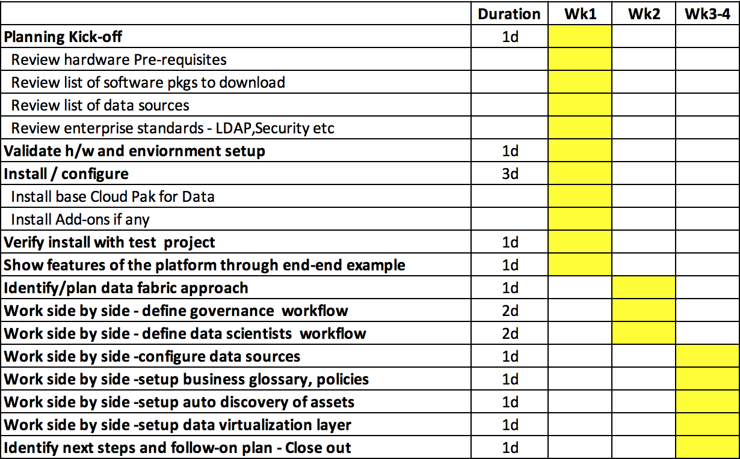
Timeline of Initiate phase – Governed DataOps + 1 year of platform support

Slide 17
Scope of Productionize phase – Governed DataOps
Services Package Overview
Work with your data governance and analytics team to productionize data fabric for your enterprise. The services will be delivered in agile fashion over 6 sprints over 12 weeks. Each sprint will focus on hardening data governance from application, security and hybrid access perspective. You will also get proactive support to operationalize your solution for one year.
Business Value
Start on the right foot with a discovery workshop to outline deployment approach and topology
Get a head-start with expert working side-side to build core platform and governance skills
Setup data fabric as central data hub for all metadata across data assets for self-service frictionless access
Deliverables
Governance and data virtualization workflows and quick start guide for user personas
Setup data sources, users, roles for governance and catalog activities
Runbook for day-2 activities and management of platform
Setup and configure examples of data fabric scenarios through data virtualization feature
Expertise Connect Advanced support: Q&A, Technical Account Management, Designated Subject Matter Expert, Proactive Assistance, Problem Management, On site Assessments
Duration and Resource
Expert Lab resources for 12 weeks, supported by a team of extended experts as needed
IBM will provide 1 year of technical assistance and guidance, their expertise connect, that will help your client to operationalize, manage, and scale their Data Fabric usecase on Cloud Pak for Data

Slide 18
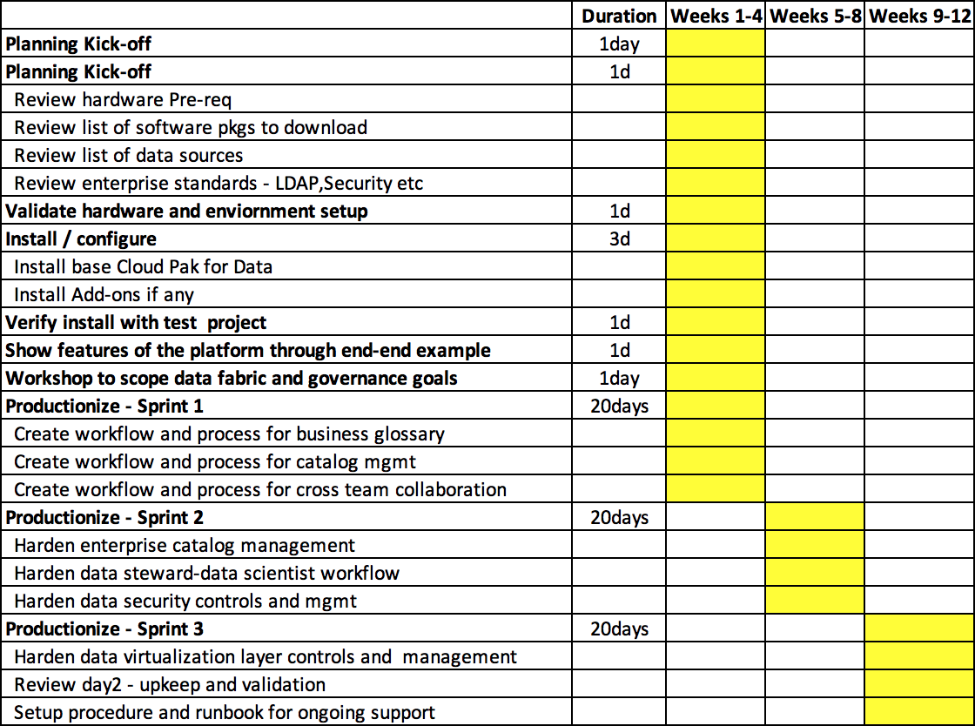
Timeline of Productionize phase – Governed DataOps + 1 year of Platform support

Slide 19
IBM Roles
Project Manager
Provides overall management of IBM resources and IBM logistics surrounding delivering the solution. Provides a point of escalation and ensures any concerns are resolved effectively.
Cloud Pak for Data Solution Architect
Cloud Pak for Data solution expert, defines solution strategy and project needs for the engagement to meet business goals. Translates business goals and client’s business needs into functional and non-functional solution requirements.
Cloud Pak for Data Governance and Data Virtualization Expert
A subject matter expert to help with the relevant hybrid data management skills for the unique client requirements such as: data governance, cataloging, and virtualization elements

Slide 20
Client Participants
Project Manager
Provides overall management of IBM resources and IBM logistics surrounding delivering the solution. Provides a point of escalation and ensures any concerns are resolved effectively.
Executive Sponsor
Guides the scope and business requirements for the solution. Available for presentations at the end of sprints 1 and 2.
Business Consultant/SMEs, Data owners
Identifies detailed business requirements for the solution and how to demonstrate business value. They are solution domain Subject Matter Experts (SMEs) to help understand business process in scope for the solution. Drives the identification and collection of business data and content to support the solution. Also act as a stand in for the end user and support agent roles.
Technical Administrator
Technical administration of the solution. Focal point for transition of technical aspects of the solution.

